Slide 1
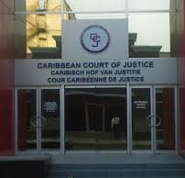
The Caribbean Court of Justice:
Symbol of Regional Integration and National Sovreignty
For the Action Group of the Methodist Church of St. Lucia
By
Sir Dennis Byron

Slide 2
Long history of Regional Courts in West Indies
1881: The British Honduras (Court of Appeal) Act: provided for the Supreme Court of Jamaica to hear appeals from British Honduras(Belize).
1919: The West Indian Court of Appeal Act: (WICA) To hear appeals from:
  Trinidad and Tobago; British Guiana; Barbados; The Leeward Islands (including the British Virgin Islands): Grenada, St. Lucia and St. Vincent
1956: The Federal Supreme Court to hear appeals from:
The same territories as WICA and Jamaica
1962: The Federal Supreme Court dissolved by British Statute (West Indies Act 1962)
when the Federation broke up the constituent countries replaced the Federal Supreme Court with national courts
1967: The establishment of the Eastern Caribbean Supreme Court
There has been a history of Regional Courts in the West Indies before the CCJ

Slide 3
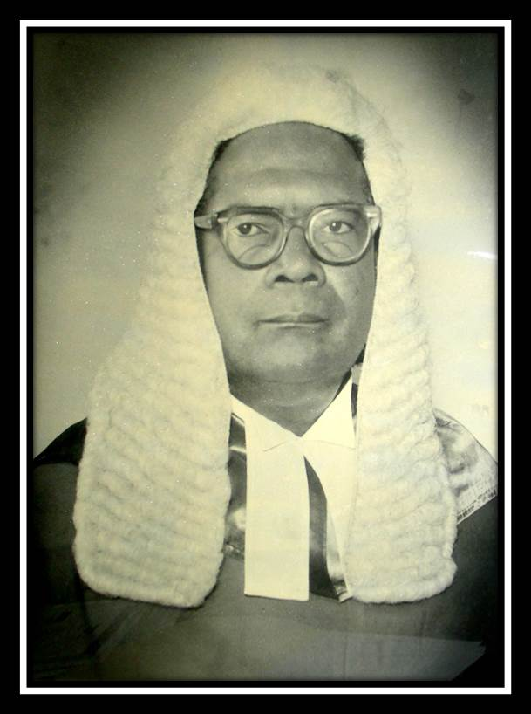
St. Lucian on Federal Supreme Court
Sir Allen Montgomery Lewis GCMG GCVO KStJ
1959: Appointed Judge of the Federal Supreme Court
1962: Appointed to court of appeal of Jamaica
1967: Chief Justice of the Court that became the ECSC
An example of St. Lucian contribution to the development of Caribbean Jurisprudence

Slide 4

The Revised Treaty of Chaguaramas (RTC) established the Caribbean Community (CARICOM) and the Single Market and Economy (CSME)
Signed 5th July 2001
The RTC affirmed that the original jurisdiction of the Caribbean Court of Justice is essential for the successful operation of the CSME
The RTC provided for the Settlement of disputes concerning the interpretation and application of the Treaty through voluntary settlement by ADR and compulsory settlement by the judicial decisions of the Caribbean Court of Justice.

Slide 5

Establishment of CCJ
Agreement establishing the CCJ was signed 14th February 2001 by 12 CARICOM countries
Antigua and Barbuda, Barbados, Belize, Dominica, Grenada, Guyana, Jamaica, St. Kitts-Nevis, Saint Lucia, St. Vincent and the Grenadines, Suriname, Trinidad and Tobago.
Dr Kenny Anthony signed for St. Lucia as the then Prime Minister

Slide 6
Rationale in the Agreement establishing the Caribbean Court of Justice Signed 14th February 2001 at St. Michaels Barbados
CONVINCED that the Caribbean Court of Justice, will have a determinative role in the further development of Caribbean jurisprudence through the judicial process;
AWARE that the establishment of the Court is a further step in the deepening of the regional integration process;
RECOGNISING the sovereignty of Members of the Caribbean Community;
The [CCJ] is hereby established with (a) original jurisdiction and (b) appellate jurisdiction

Slide 7
The Effect of the Agreement
Saint Lucia, like every other CARICOM state, automatically became part of the court’s Original Jurisdiction and agreed to have its final appeals heard by the CCJ.
A principle in international law is that treaties must be obeyed in good faith. By acceding to the Appellate Jurisdiction Saint Lucia will fall into compliance with this bedrock principle of the law of treaties.
Barbados, Guyana, Belize and the Commonwealth of Dominica have all taken this significant step

Slide 8

CCJ Inaugurated 2005 with its seat at 134 Henry Street, Port of Spain, Trinidad

Slide 9
The Regional Judicial and Legal Services Commission is an independent body of 11 persons independently appointed and guarantees that the selection process is uncontaminated by political or other interference.
It selects and appoints the Judges and support staff
The President of the CCJ is Chairman.
2 ex officio chairs of a Judicial Service and Public Service Commission of Member States rotating every three years,
2 persons from civil society nominated jointly by the Secretary General of CARICOM and the Director General of the OECS;
2 persons nominated jointly by OCCBA and the OECS Bar Associations,
2 persons nominated jointly by the Regional Law Schools, and
2 persons nominated jointly by the Bar Associations/ law societies of the Contracting Parties.
To date, the following Saint Lucians have served terms of office on the Commission, namely: The Right Honourable Sir Vincent Floissac; Mr. Frank Myers; Mr. Egbert Lionel; Mr. Evaristus Jn. Marie and Mr. Tyrone Chong, QC.

Slide 10
Independent Court
The judges and staff of the Court are selected by the Regional Judicial and Legal Services Commission that is entirely independent of any form of political control or influence.
The President of the Court is selected by the Commission and appointed by the votes of at least three-quarters of the Heads of CARICOM States. The President serves a non-renewable 7-year term.
The court has a judicial complement of six other Judges selected and appointed by the RJLSC. From its inception there have been three Presidents and a total of 13 judges, with a retirement age of 75.
The commission also selects and appoints the Court Registrar and Registry team and the more than 100 professional and management team and staff that support the judicial functions of the Court.

Slide 11
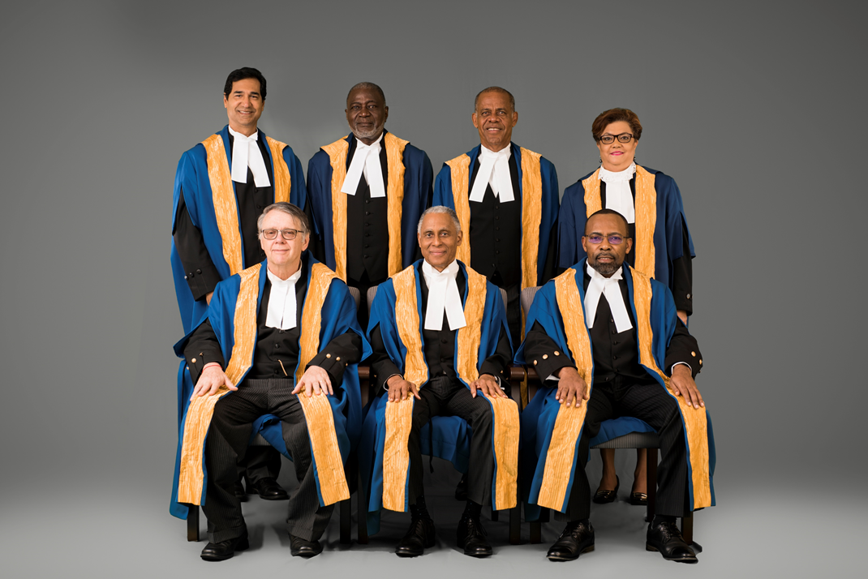
Current judicial complement: an ethical body with a highly regarded mix of academic, legal and judicial experience.
Honourable President
Adrian Saunders, - St. Vincent and the Grenadines
Honourable Judges:
Jacob Wit – The Netherlands
Winston Anderson - Jamaica
Maureen Rajnauth-Lee – Trinidad and Tobago
Denys Barrow - Belize
Andrew Burgess - Barbados
Peter Jamadar - Trinidad and Tobago

Slide 12

Funding the Court
The court is funded from the proceeds of a trust fund established by the States of CARICOM capitalised at US$100 million. Saint Lucia’s payment was US$2.1million.
The $100 million were placed in the hands of a Board of Trustees whose remit is to invest that money so that the yield on that investment will finance the Court’s operating budget. This mechanism is the envy of all international courts because it strengthens the Court’s financial independence and insulates the court from the possibility of political pressure being exerted upon it.
The system is sustainable: In its 2020 report is reported that over the 15 years of its existence it had already disbursed to the sum of US$93,888,116.00 for the Court’s operational expenditure

Slide 13
CCJ actively engaged in enhancing rule of law
In 2020/21 Annual report Strategic plan includes enhancing regional system capacity and performance:
The CCJ’s Academy of Law under chairmanship of CCJ Justice Winston Anderson – the court’s educational arm: a current project is the honouring 34 pioneering Caribbean Women Jurists including the late Mme Justice Marie Elizabeth Bourne-Hollands born in Morne Fortune here in St. Lucia. She was the first woman Judge of the Commonwealth Caribbean.
The Caribbean Association of Judicial Officers under chairmanship of CCJ Justice Peter Jamadar. The Vice-Chair? Saint Lucia's Hon Justice Vivian Georgis Taylor-Alexander: informative electronic newsletter, training initiatives for judicial officers and grand biennial conference held on each occasion in a different CARICOM state.
The CCJ is the executing agency for the $20million Canadian Aid (JURIST) Project which has done much to improve the administration of justice across the region, including in the Organisation of Eastern Caribbean States (OECS).
The Annual Moot on International/CARICOM Law for the Regional law faculties and law schools to support training of law students
Among many other projects:

Slide 14
Caribbean Lawyers Appear before Highest Court
LAWYERS APPEARING BEFORE THE COURT IN THE APPELLATE JURISDICTION
TYPE | GUYANA | B’DOS | BELIZE | T&T | TOTAL
SILK | 13 | 21 | 19 | 3 - - - | 56
JUNIOR | 90 | 63 | 18 | 3 - - - | 174
TOTAL | 103 | 84 | 37 | 6 - - - | 230
LAWYERS APPEARING BEFORE THE COURT IN THE ORIGINAL JURISDICTION
TYPE | GUYANA | B’DOS | BELIZE | T&T | JAMAICA | SURINAME |  | OTHER COUNTRIES (CARICOM Grenada, Dominica, Antigua, AG’s, CJ’s)
SILK | 2 | 7 | - | 5 | 2 | - |  | 8 | 24
JUNIOR | 11 | 10 | 4 | 31 | 17 | 3 |  | 13 | 89
TOTAL | 13 | 17 | 4 | 36 | 19 | 3 |  | 21 | 113

Slide 15
Court Excellence
The Caribbean Court of Justice is accepted into the International Consortium for Court Excellence (ICCE).
A quality management system based on universal core values, and seven areas of court excellence actionable performance measures.
This is an external validation of the Court’s effective delivery of high quality judicial service
Caribbean lawyers who have appeared before the CCJ have expressed that their sense of being in a place where they belong eliminates a certain measure of discomfort and stress.
Litigants have expressed a similar experience of feeling comfortable to repose trust and confidence in judges who have a more intimate appreciation of the milieu in which their disputes arise.

Slide 16

Access the Appellate Jurisdiction Now
Accession to both jurisdictions of the Court by the CARICOM Member States, is the best solution for the harmonization of our Community domestic laws and to create judicial consistency across the region

Slide 17
Procedure for accession to by St. Lucia is judicially clarified
The Eastern Caribbean Court of Appeal in the Attorney General’s Reference (Constitutional Questions) [2013] ECSC JO524-5 ruled that for the purposes of altering the Constitution to replace appeals to Her Majesty in Council with appeals to the Caribbean Court of Justice, St. Lucia may validly enter into an agreement with the United Kingdom and then pass a bill to that effect as prescribed by provisions of Section 41 of the constitution

Slide 18



CCJ IS UNIQUE
IT IS
TWO COURTS IN ONE
ORIGINAL JURISDICTION
To exercise Exclusive and Final adjudication on disputes between member states or between persons and member states concerning the interpretation and application of the Treaty of Chaguaramas
This is similar to the European Court of Justice
APPELLATE JURISDICTION
To hear Appeals from decisions of
the Court of Appeal of contracting
Parties
This is similar to the Privy Council

Slide 19
What type of disputes can come before the Court in its Original Jurisdiction?
Article 187 of the RTC
(a) allegations that an actual or proposed measure of another Member State is, or would be, inconsistent with the objectives of The Community;
(b) allegations of injury, serious prejudice suffered or likely to be suffered, nullification or impairment of benefits expected from the establishment and operation of the CSME;
(c) allegations that an organ or body of The Community has acted ultra vires; or
(d) allegations that the purpose or object of the Treaty is being frustrated or prejudiced.

Slide 20
Examples of claims brought by Private Entities
Against Member States
Suspension of CET contrary to Art 82/83
On Cement: TCL and TCI Guyana v Guyana [2009] CCJ 1 (OJ)
On Flour: Hummingbird v Suriname [2012] CCJ 5 (OJ)
Violation of freedom of movement contrary to Art 45
Shanique Myrie v Barbados [2012]CCJ 3(OJ)
Against the Community
Violation of power regarding suspension of CET
TCL V The Community [2009] CCJ 4 (OJ)
Against the Competition Commission
Judicial Review of decision to investigate
TCL v Competion Commisssion [2012] DDSJ 4(OJ)

Slide 21
Example of a claim brought by Member State
Belize brought claims against St. Kitts-Nevis and Trinidad and Tobago, and the Caribbean Community for breaches of the Treaty obligations to impose special tariffs to protect regional manufacturers:
In this case the sugar exports of Belize suffered because of alleged failure to apply the agreed tariffs against sugar imports from Guatemala and the Dominica Republic
The original jurisdiction of the CCJ is essential for the interpretation and application of the Treaty provisions giving effect to the CSME

Slide 22
APPELLATE JURISDICTION
Development of Caribbean Jurisprudence
  Access to Justice: In Forma Pauperis, Use of Technology
    Elizabeth Ross v Coreen Sinclair
  Promoting Good Governance and Accountability: Caribbean Battle against Corruption
    Florencio Marin and Jose Cove v The Attorney General of Belize
  Protection of Human Rights: The Constitution and the Impact of International Treaties
    Attorney General and Others v Joseph and Boyce

Slide 23
APPELLATE JURISDICITON
  Fair Trials: Rising Crime, Delay and Right to Fair Trial
    Frank Errol Gibson v the Attorney General of Barbados
  Pre-Trial Detention: Impact on Sentencing
    Romeo Da Costa Hall v The Queen

Slide 24
Validity of jurisprudence
What of the quality and integrity of the Court’s jurisprudence? The CCJ’s judgments are delivered in a timely fashion and are regarded by other courts, regionally and internationally, with the utmost respect.
The Privy Council in a recent case Commissioner of Prisons and another v Seepersad and another [2021] UKPC 13 indicated that in Maharaj v Prime Minister of Trinidad and Tobago [2016] UKPC 37 “Lord Kerr in delivering the unanimous judgment of the Board quoted with approval the passages in Joseph and Boyce and Maya Leaders noted above.”

Slide 25
Appeals to the Privy Council has dwindled throughout the Commonwealth
The Privy Council was final court of appeal for a quarter of the world. But the movement away from colonialism changed things. Today if one excludes the Caribbean countries, there are only four small independent countries who retain appeals to the Privy Council:
Mauritius: population 1.3 million.
Kiribati: population 120,00:
Tuvalu: population 12,000
The Cook islands and Niue: population 17,000

Slide 26
Human Rights motivation for political and judicial Independence
1948: the Universal Declaration of Human Rights initiated the movement to end colonialism as the United Nations reaffirmed their faith in fundamental human rights, the dignity and worth of the human person and in the equal rights of men and women and determined to promote social progress and better standards of life in larger freedom
1Sir Allen Montgomery Lewis GCMG GCVO KStJical960: the United Nations Declaration on granting independence to Colonial Countries and Peoples: General Assembly resolution 1514(XV) The subjection of peoples to alien subjugation, domination and exploitation constitutes a denial of fundamental human rights; Inadequacy of political, economic, social or educational preparedness should never serve as a pretext for delaying independence
1962 onwards: Jamaica: Trinidad and Tobago: Guyana:
then other Caribbean countries become independent
Judicial independence reflects the human right of equality by removing subordination to the former colonial authority

Slide 27
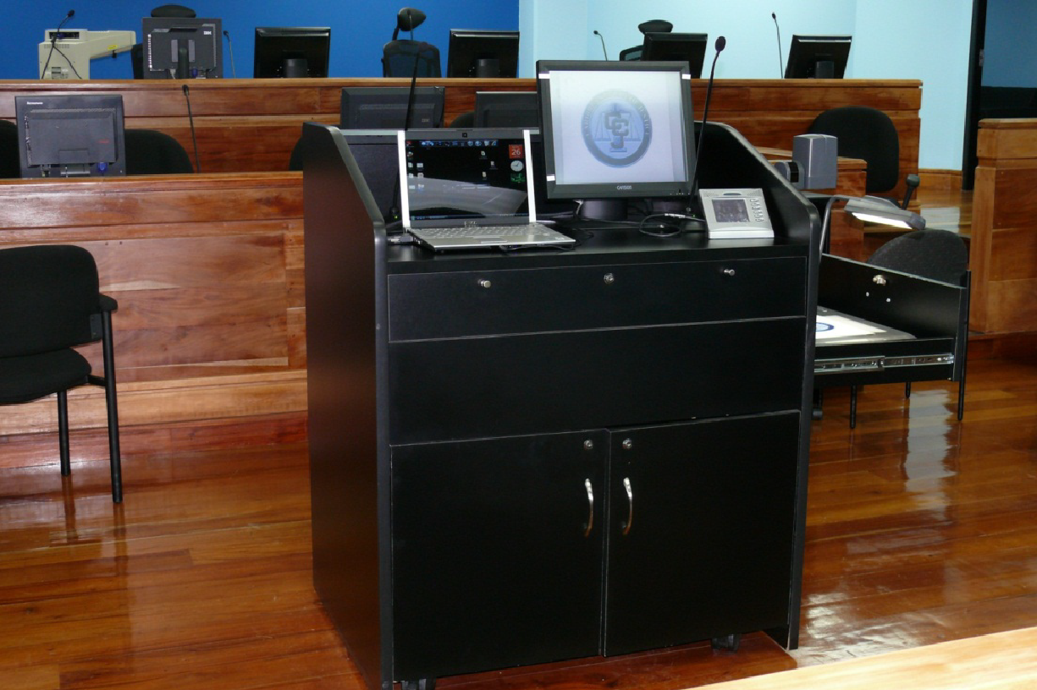
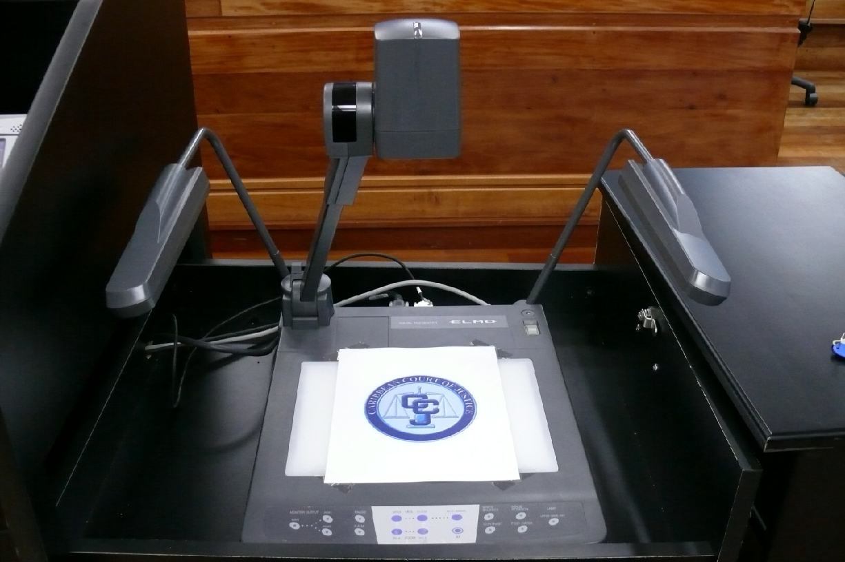
Use of technology
Electronic filing and service of court records
Court proceedings by Videoconferencing
Official Transcripts are digital Audio/video recordings
Technology in Courtroom

Slide 29
Singing Sandra: on the 50th Anniversary of Trinidad Independence:
Leave you mamy house and join the CCJ
Like some love the breeze up in London while they scorn we own CCJ
And when you ask them what's their position, "That's not a priority," they say
We who gave the world Sir Hugh Wooding, Telford Georges, De la Bastide
To their judgement we must keep bowing, most insulting indeed!
Source: Singing Sandra - On reaching fifty - T&T CALYPSO
https://www.youtube.com/watch?v=2rtcPNuy1ww

